Slide 1
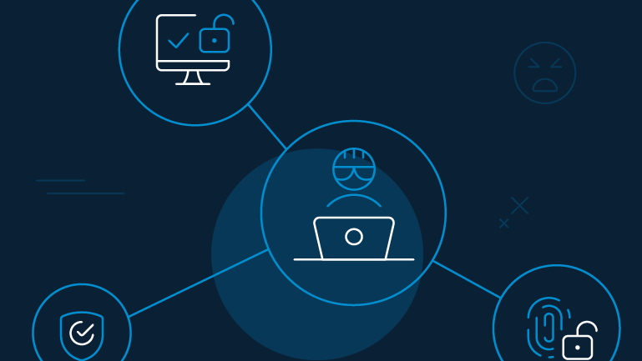
Social Engineering
Staying safe on Social Media

Slide 2

What exactly is Social Engineering?
Tricking people into providing sensitive information, data, money or access to any organization or building.
Attackers trigger human behaviour such as fear, greed, urgency, curiosity and trust
Example: A person tries to get in behind you into the building when you are accessing the building.

Slide 3
Its impact on Social Media Users
Identity Theft: Attackers could impersonate you using your data from social media platforms.
Financial Loss: Using social engineering techniques, scammers could trick you into sending money or sharing financial credentials.
Account Hacking: Hackers could gain access by fooling users into entering passwords on fake login pages or clicking malicious links. They can use it to ransom users or misuse the account itself.
Cyberbullying: Users, especially students become victim of cyberbullying and fake relationship scams resulting in emotional and psychological harm.

Slide 4
Social Engineering Techniques
Phishing
Hackers pretending to be a trusted organization send in fake emails, texts or messages containing a malicious link or attachments which if clicked will compromise the system an its contents.
Example: User receives an email telling he has been chosen and will get 100000£ and just needs to click in the random link.

Slide 5
Social Engineering Techniques
2. Tailgating
An unauthorized person pretending to be a colleague or employee, following behind while gaining access to a secure building or room.
Example: A person pretending to be pizza delivery guy asks you to keep the door open for him.

Slide 6
Social Engineering Techniques
3. Baiting
Hackers offer something tempting to trick users into provide information or use their malware. The baits in this scenario includes free downloads, prizes, USB drivers etc.
Example: A USB stick labelled ”Exam Answers” is lying on student’s desk which may contain malicious software.

Slide 7
How to stay safe while using social media?
Be careful with links, downloads, and messages: Do not click suspicious links, open unknown attachments, or download files from untrusted websites. Report any suspicious activity to the teacher or IT manager.
Protect your accounts and passwords: Use strong unique passwords, enable multi-factor authentication (MFA), and never share login details with anyone.
Verify people and requests before responding: Check identities carefully and do not trust unexpected emails, calls, friend requests, or messages asking for personal information.
Protect your personal and college information: Limit what you share on social media, use privacy settings, and keep college data confidential.
Keep devices secure and report suspicious activity: Keep antivirus software updated, avoid using unknown USB devices, log out of shared computers, and report suspected security breaches within 24 hours.

